Slide 1
Online News Database
Group One
Kai Tian, Weiyang Qian, Yue Zhou, Danni Chen

Slide 2
Introduction
Database Purpose:
To collect, store, maintain and manage data for an online news system
To offer data for an artificial intelligence recommendation system and product optimization
Business Problems Addressed:
Allow administrative, media relations and news relations practitioners to generate statistic reports
Supply insight to drive targeted marketing segments based on gender and age
Permit news contributors to analyze and refine news content
Provide information to help news contributors to reasonably price news
Provide information to help optimize media product and intelligently recommend interesting news
Provide information to help make a reasonable advertising strategy to maximize benefits

Slide 3
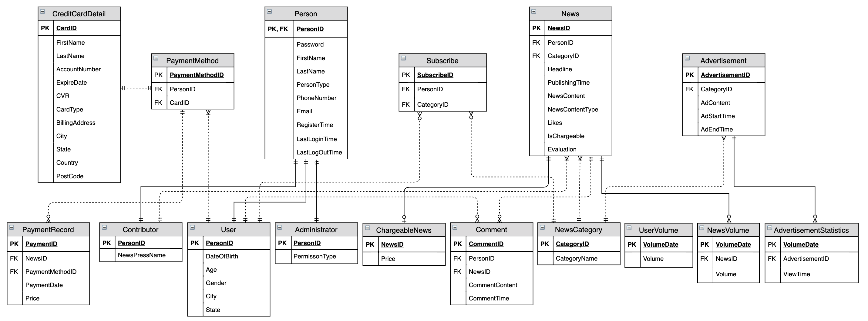
Entity-Relationship Diagram
There are 16 entities including 4 main parts: Person, Payment, News, Statistics.

Slide 4
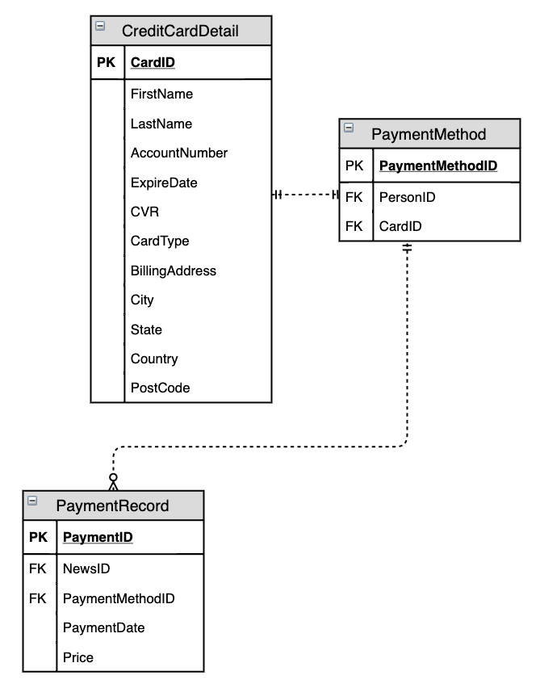
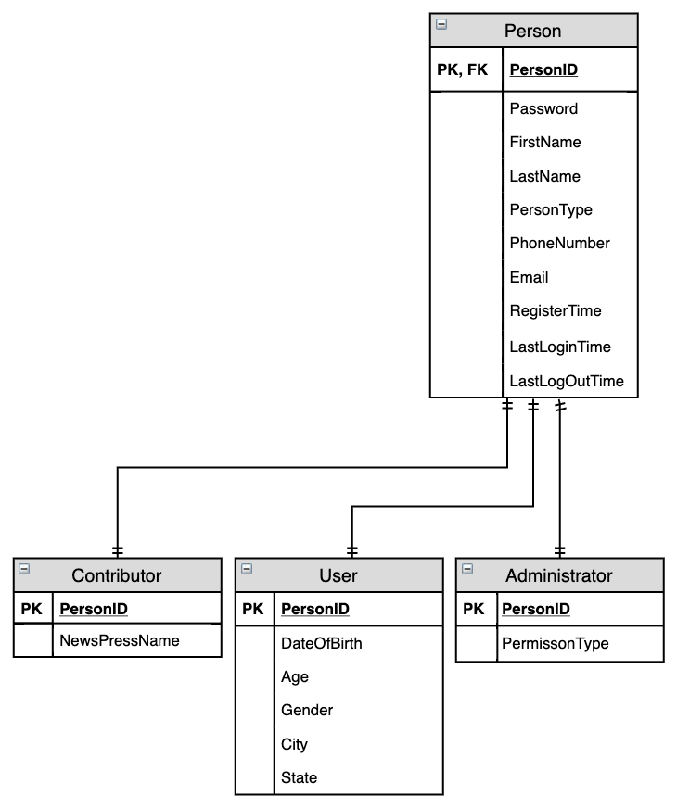
Entity-Relationship Diagram
Payment
Person

Slide 5
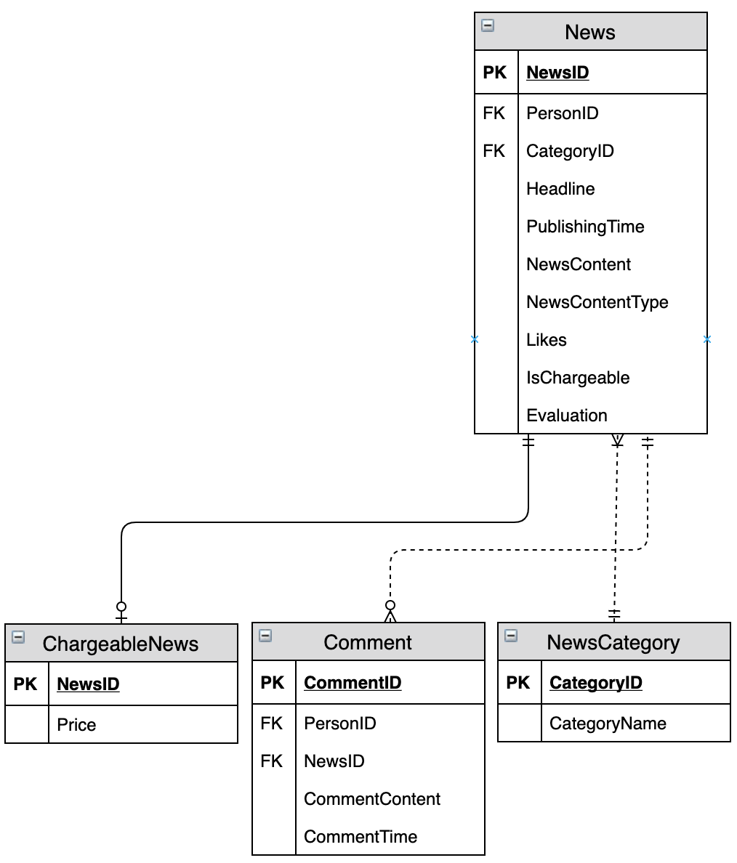
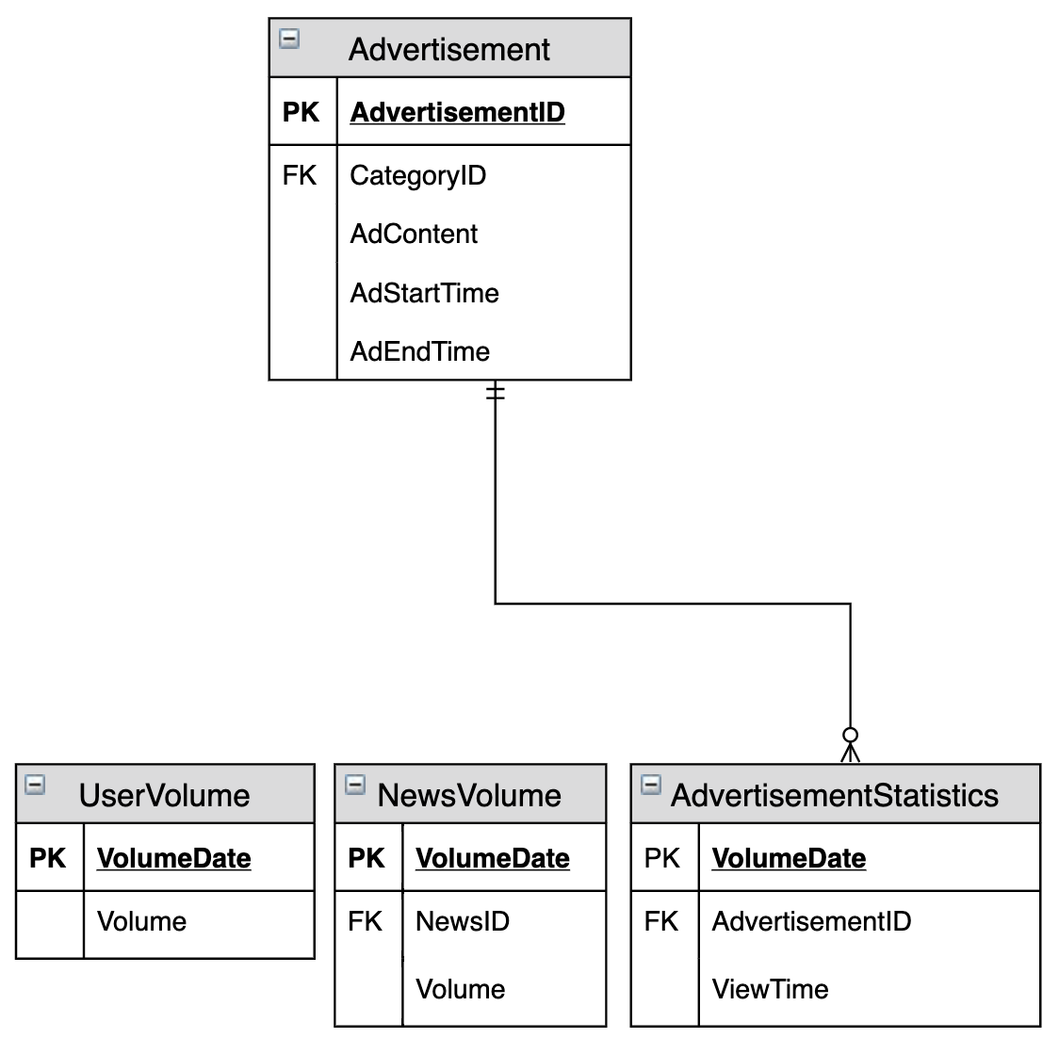
Entity-Relationship Diagram
News
Person
Statistic

Slide 6
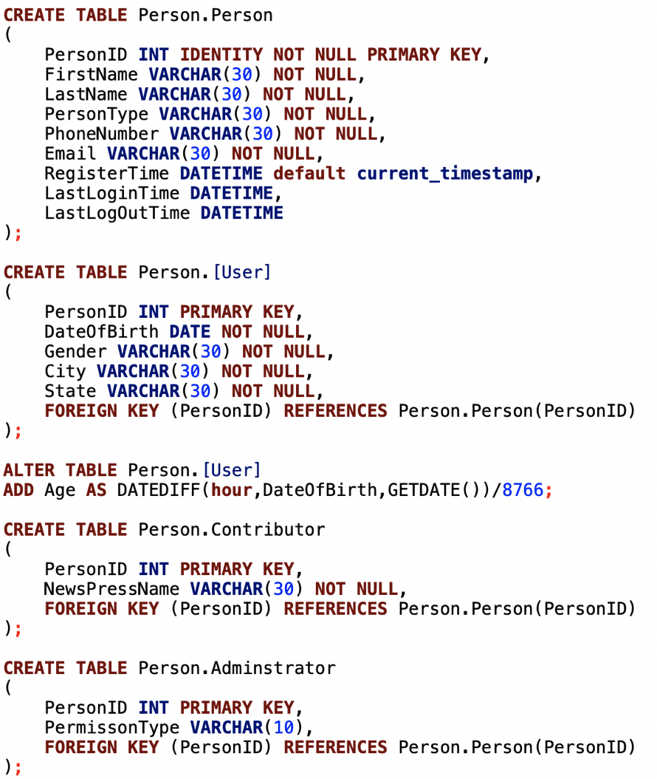
Data Implementation – Person

Slide 7
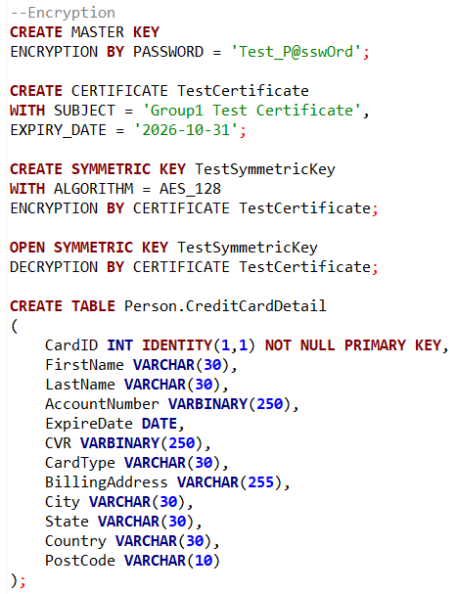
Data Implementation – Payment

Slide 8
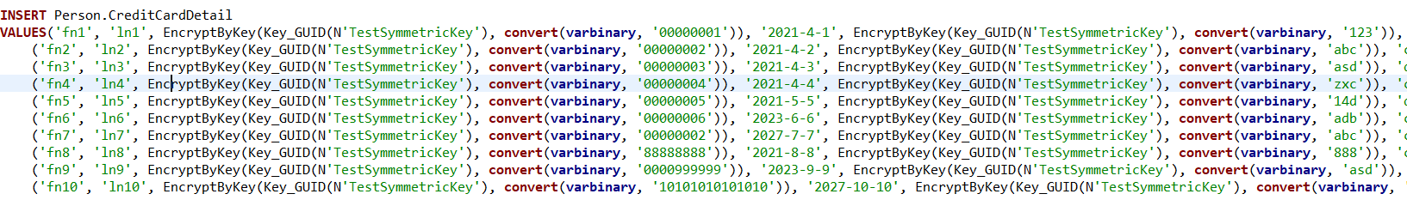
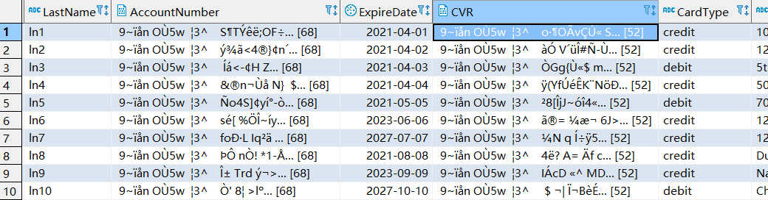
Data Implementation – Payment Record Encryption
Encryption During Insert
Data Encrypted in Database

Slide 9
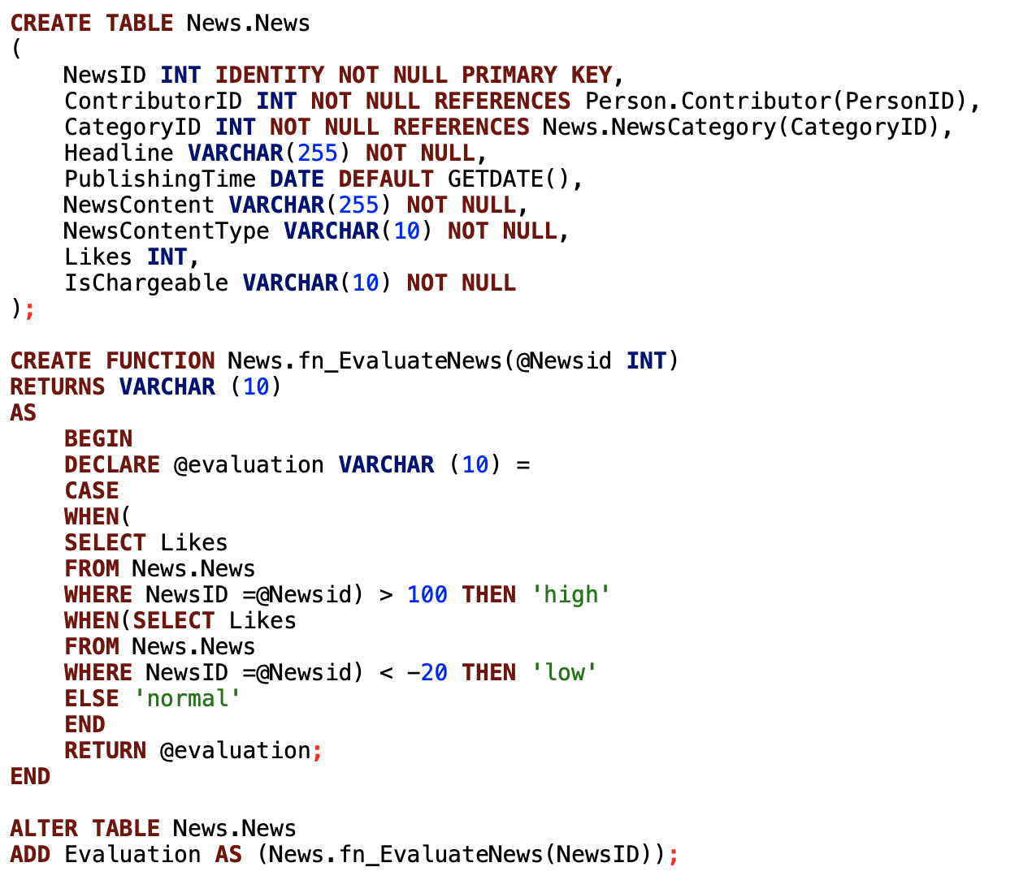
Data Implementation – News

Slide 10
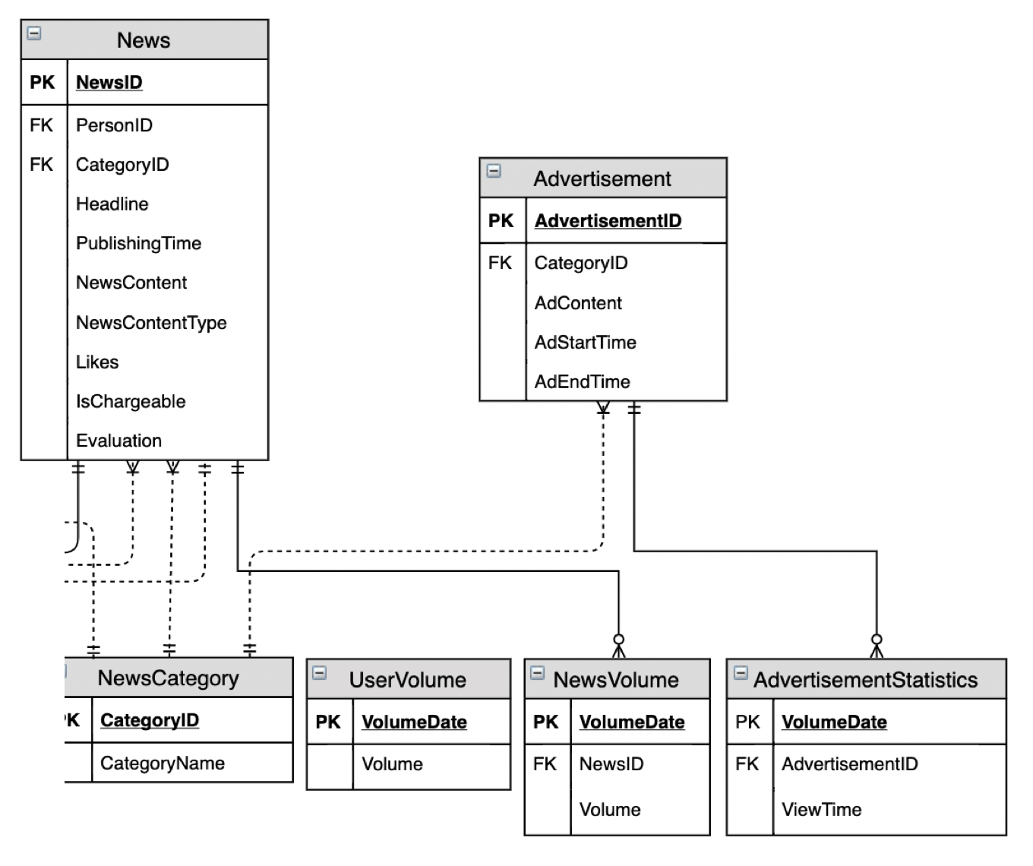
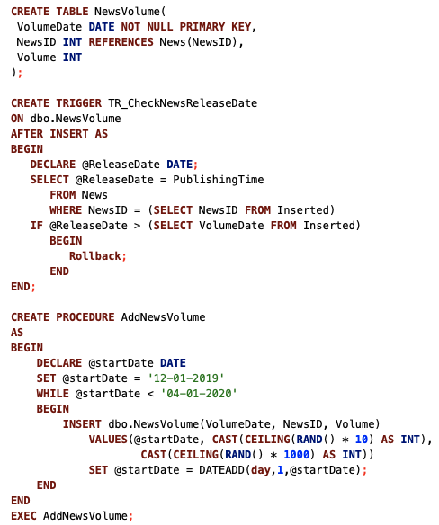

Data Implementation – Statistics

Slide 11
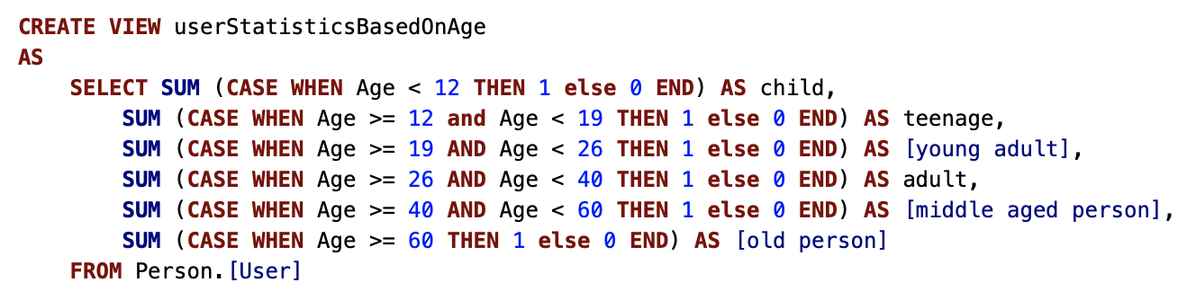
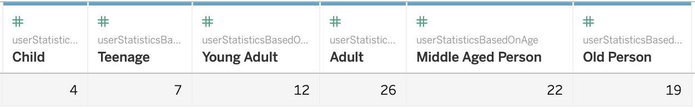
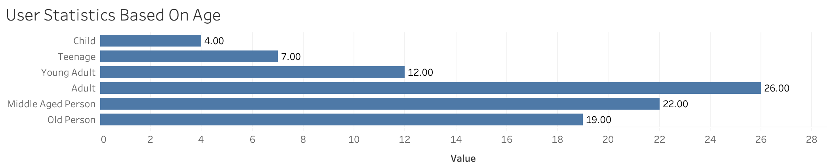
Reports & Visualization
User Statistics Based on Age

Slide 12
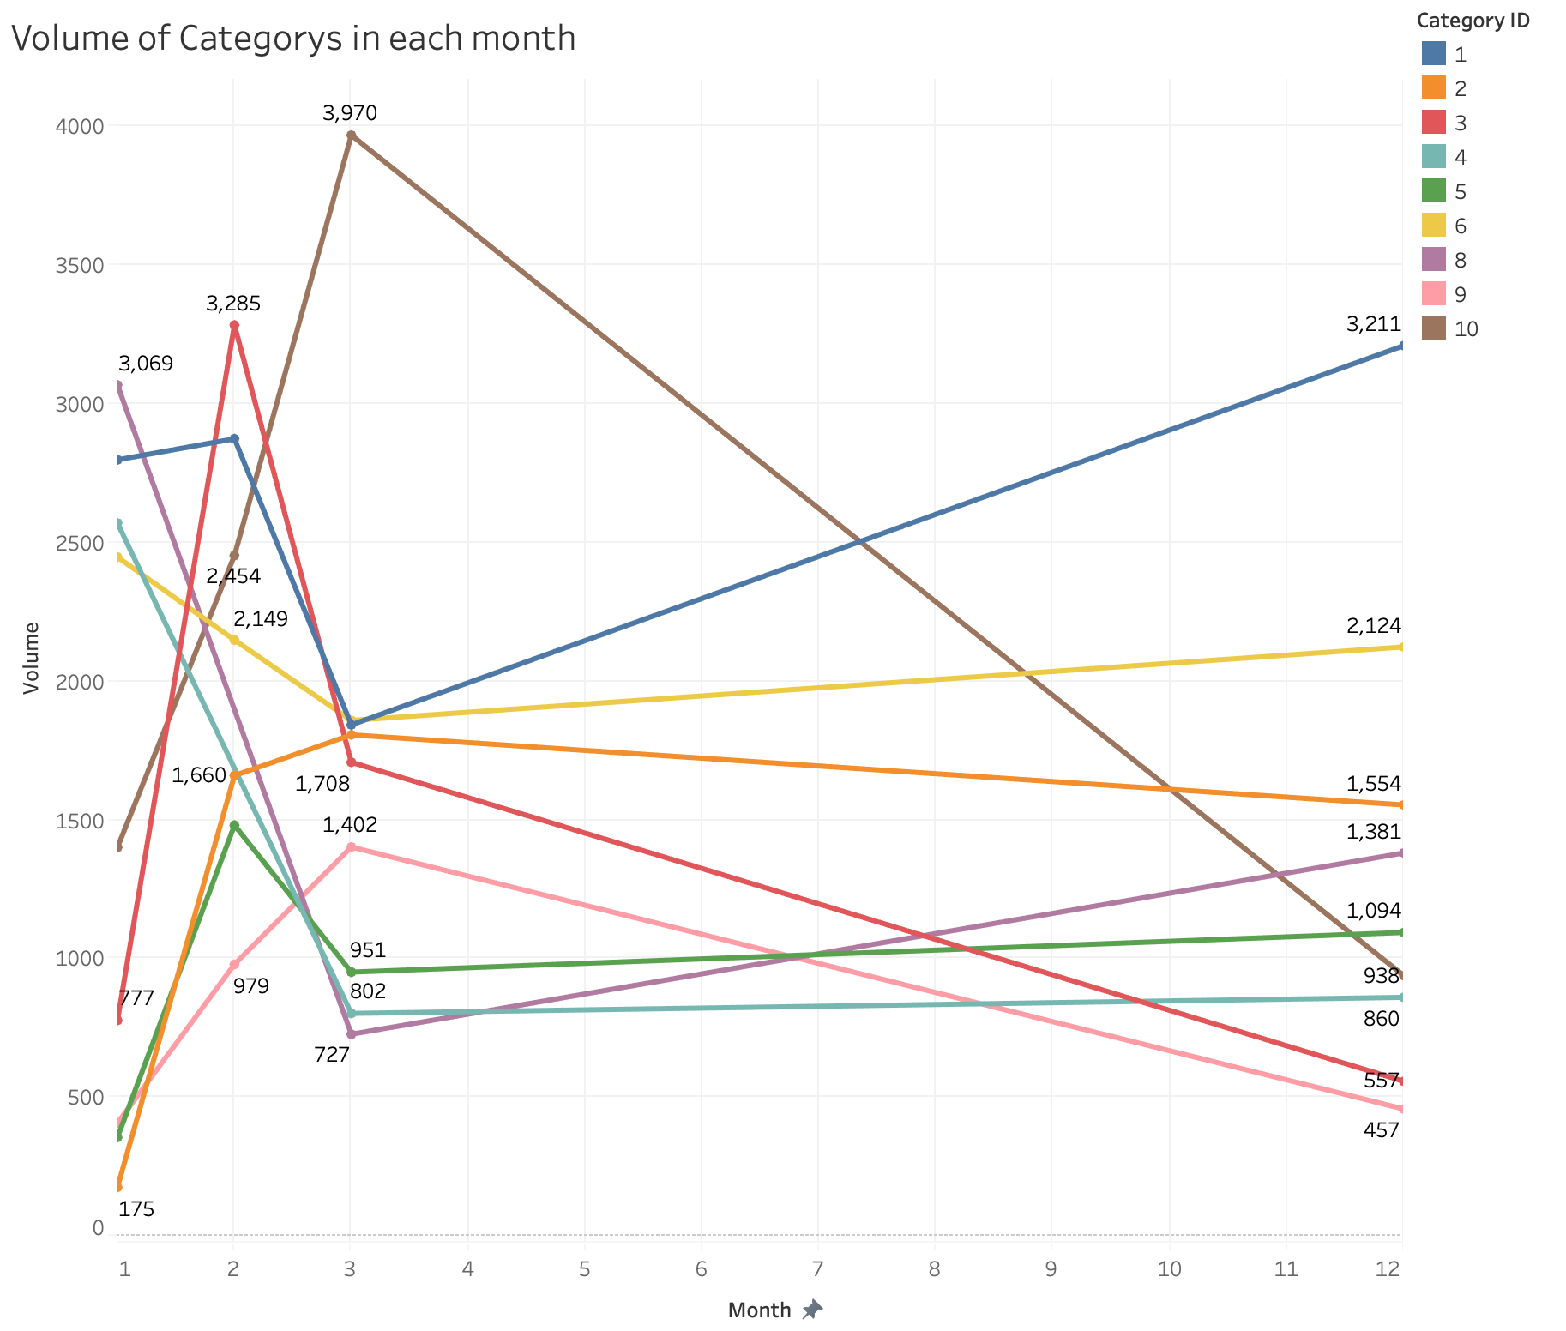
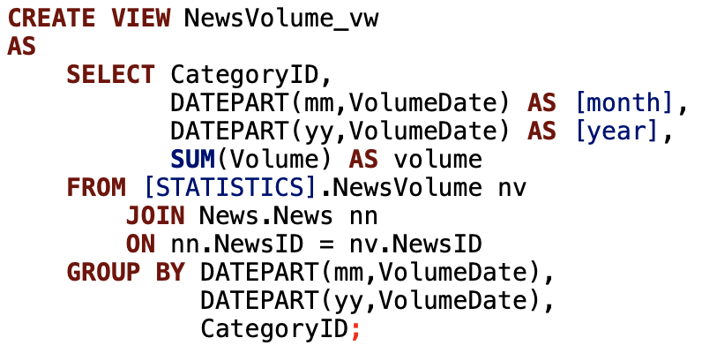
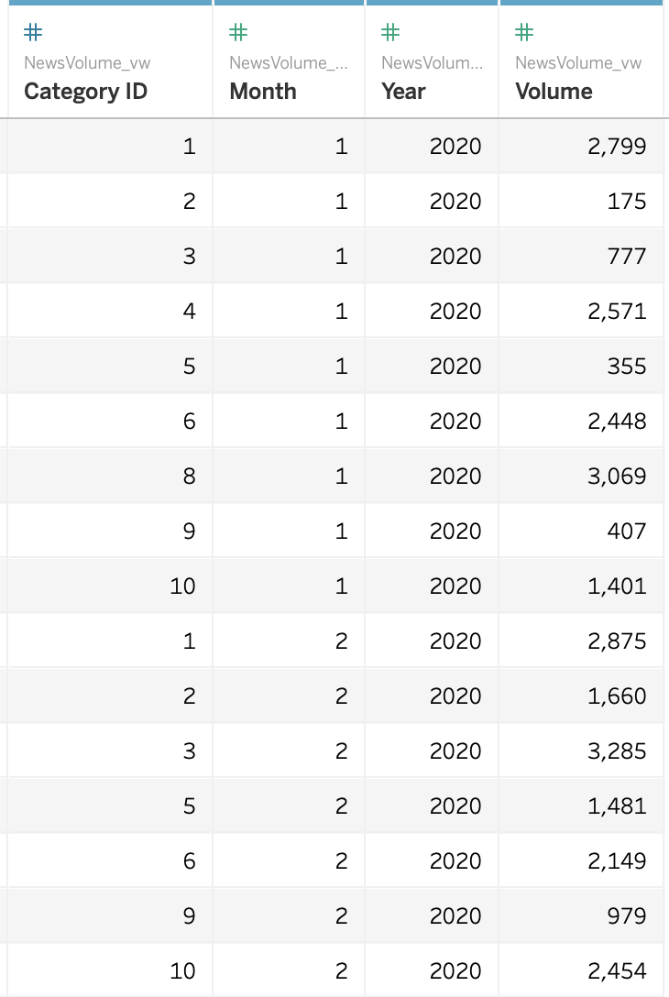
Reports & Visualization
Volume of Category in Each Month

Slide 13


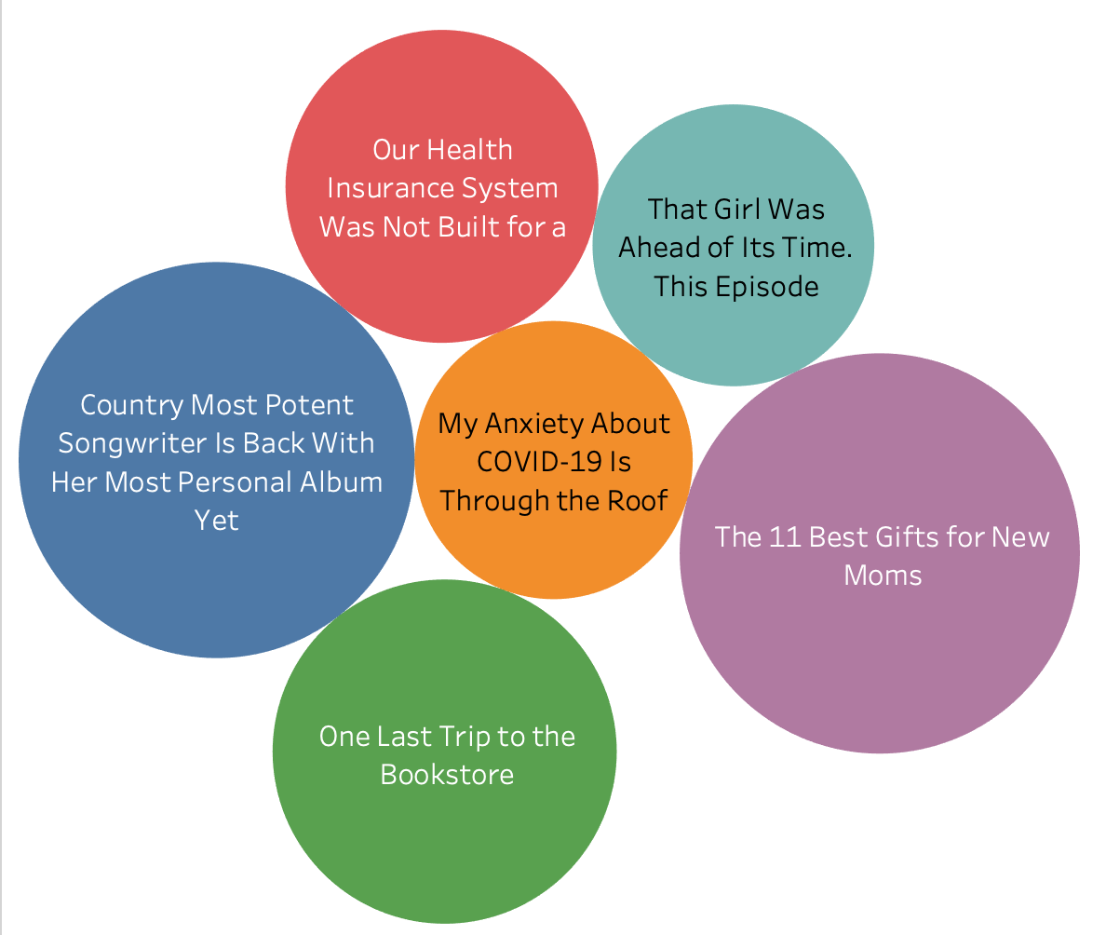
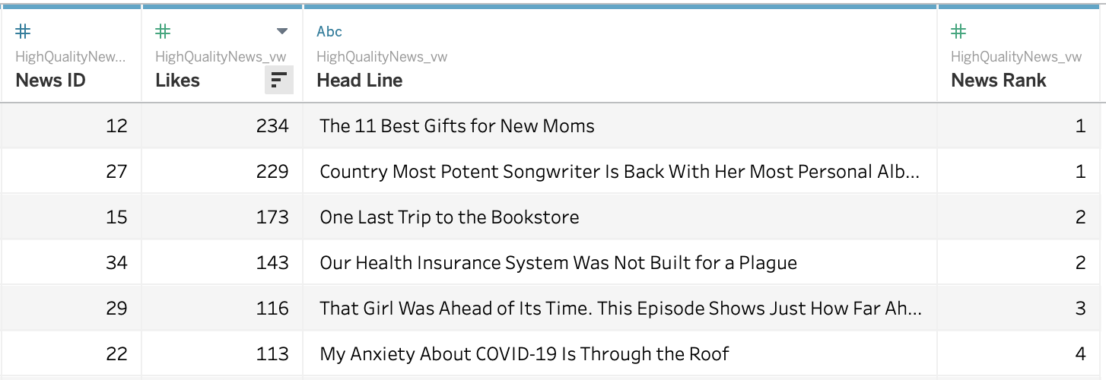
Reports & Visualization
Daily High-Quality News Analysis – Rank by User Likes

Slide 14
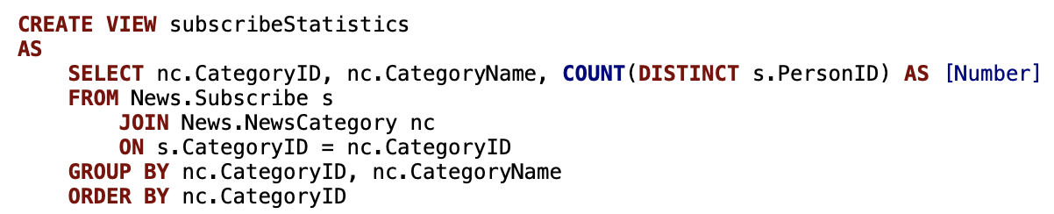
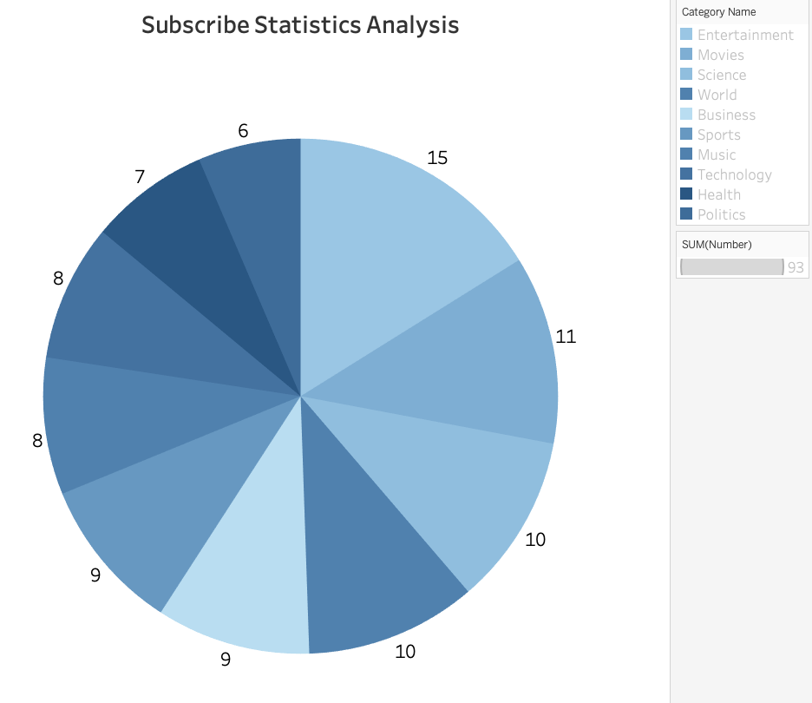
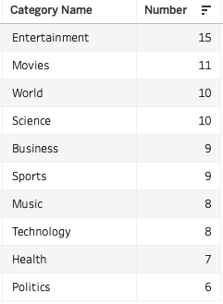
Reports & Visualization
Subscribe Statistics Analysis – Based on Total User Subscription

Slide 15
Thank you
Q&A

